Slide 2
Tutorial: Building Machine Learning Applications with Microsoft R Server on SQL Server and Spark
Xinwei Xue, Principal Data Scientist
Carl Saroufim, Data Scientist
Yuzhou Song, Data Scientist II
James Ren, Senior Data Scientist
Algorithm & Data Science, Data Group

Slide 3
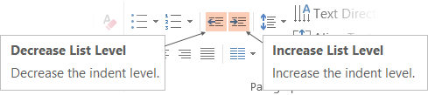
Adjusting list levels
Main topic 1: size 40pt
Size 20pt for the subtopics
Size 20pt for the subtopics
Main topic 2: size 40pt
Size 20pt for the subtopics
Size 20pt for the subtopics
Main topic 3: size 40pt
Size 20pt for the subtopics
Size 20pt for the subtopics
Use the “Decrease List Level” and “Increase List Level” tools on the Home Menu to change text levels.
Try this:
Place your cursor in any row of text to the left that says “Size 20pt for subtopics”
Next click the Home tab, and then on the “Decrease List level” tool. Notice how the line moves up one level.
Now try placing your cursor in one of the “Main topic…” lines of text. Click the “Increase List Level” tool and see how the text is pushed in one level
Use these 2 tools to adjust your text levels as you work

Slide 4
Agenda
Introduction: 10 mins
Microsoft R Server (MRS)
Marketing Campaign Optimization
MRS for SQL Server R Services: 25 mins
Develop from R IDE
Deploy as SQL Stored Procedures
Learnings
MRS for Spark: 25mins
MRS for Spark
Benchmarking
Learnings
Hands-on time : 60 mins
SQL Server R Services (CIQS)
Spark Cluster

Slide 5

Introduction: Microsoft R Server Scales Analytics to Big Data
Scales via parallelization
Scales via in-cluster execution
Escapes R’s memory limitations
Reduces data movement & duplication
Deploys into multiple platforms
Windows, Linux
SQL Server (R Services)
Hadoop/Spark
Teradata
f(x)
DeployR
R Open
R Server
ConnectR
R+CRAN
RSR Connector
ScaleR
DistributedR
Open Source Components
Licensed Components
Notes:
Slide Objective
Focus the discussion of Microsoft R Server on its primarly function - parallelize analytical work – particularly data transformation and model training
List the key advantages of the R Server design.
Talking Points
As a background, Microsoft R Server is designed to help efficiently process large amounts of data for the purpose of predictive modeling.
R Server’s primarly means to scaling analytics beyond what open source R can do are:
R Server enables tasks to be broken up into many small portions of work, that can be distributed transparently.
By making parallelized computations transparently, R programmers need not be concerned with the mechanics and of parallelism and the tedious coding it requires.
R Server can parallelize the same computation in many ways – using threads in a single machine, using multiple CPUs in a server or by distributing work across many machines in a cluster (like Hadoop or Hadoop with Spark).
With work parallelized, subject datasets need not be loaded into a single machine, overcoming one of R’s most painful limitaitions – one
<segue> And so, Microsoft preserves the capabilities of R, but enables them to be applied to extremely large data assets, at speed…
Additional acceleration is possible when running inside of databases and clustered systems like Hadoop and Spark because data is not moved out of the cluster or database, rather, it is processed locally.
R Server scales by moving the work to the data, not the other way around.

Slide 6
Microsoft R Server family
From Data To Action On Premises and In the Cloud
Data Sources
People
Apps
Microsoft R
Apps
Windows
SQL Server
Sensors and devices
Hadoop
Linux
Automated Systems
Teradata
DATA
INTELLIGENCE
ACTION
Notes:
Slide Objective
Introduce the variety of platforms supported by Microsoft R.
Setup for subsequent discussion of portability – Write Once Deploy Anywhere (WODA, to be covered later in the presentation).
Talking Points
Microsoft’s R Server and SQL R Services products provide users with a broad family of R-based predictive analytics tools.
Support includes stand-alone, clustered and in-database options, and several choices for in-cloud analytics as well.
While historically data science has focused on creating insights, R Server not only serves the development of insights, but also the direct deployment of automated systems that extend apps to include predictive and prescriptive actions.
Notes
Avoid discussing WODA at this point if you can, there’s another slide dedicated to portability later in this deck.

Slide 7
The Microsoft R Server Platform
DeployR
R+CRAN
Open source R interpreter
R 3.2.2
Freely-available huge range of R algorithms
Algorithms callable by MSR
Embeddable in R scripts
100% Compatible with existing R scripts, functions and packages
R Open Microsoft R Server
ConnectR
ConnectR
High-speed & direct connectors
Available for:
High-performance XDF
SAS, SPSS, delimited & fixed format text data files
Hadoop HDFS (text & XDF)
Teradata Database (TPT)
EDWs and ADWs
ODBC
ScaleR
DistributedR
R+CRAN
RSR Connector
ScaleR
Ready-to-Use high-performance big data big analytics
Fully-parallelized analytics
Data prep & data distillation
Descriptive statistics & statistical tests
Range of predictive functions
User tools for distributing customized R algorithms across nodes
Wide data sets supported – thousands of variables
RevoR
Performance enhanced R interpreter
Based on open source R
Adds high-performance math library to speed up linear algebra functions
DistributedR
Distributed computing framework
Delivers cross-platform portability

Slide 8
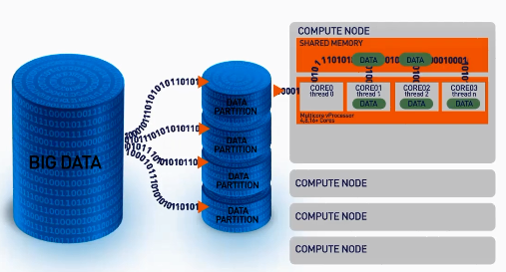
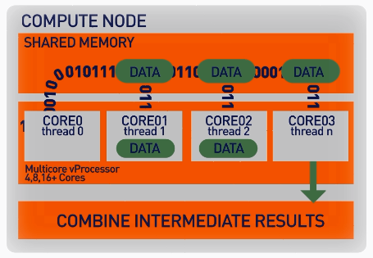
ScaleR – Parallel + “Big Data”
Our ScaleR algorithms work inside multiple cores / nodes in parallel at high speed
Stream data in to RAM in blocks. “Big Data” can be any data size. We handle Megabytes to Gigabytes to Terabytes…
Interim results are collected and combined analytically to produce the output on the entire data set
XDF file format is optimised to work with the ScaleR library and significantly speeds up iterative algorithm processing.
Notes:
DistributedR and ScaleR work together to stream blocks of data into the Revolution server and distribute the work across cores and nodes. The PEMA’s for calculation operate inside the cores and interim results are collected and combined to produce the output. This shows how Revolution R overcomes the memory constraints of open source R and achieves high speed calculation through the use of PEMA’s, Intel Math Kernal Libraries and parallelised work.

Slide 9

Scale R – Parallelized Algorithms & Functions
Data Preparation
Statistical Tests
Variable Selection
Data import – Delimited, Fixed, SAS, SPSS, OBDC
Variable creation & transformation
Recode variables
Factor variables
Missing value handling
Sort, Merge, Split
Aggregate by category (means, sums)
Chi Square Test
Kendall Rank Correlation
Fisher’s Exact Test
Student’s t-Test
Stepwise Regression
Simulation
Sampling
Simulation (e.g. Monte Carlo)
Parallel Random Number Generation
Subsample (observations & variables)
Random Sampling
Descriptive Statistics
Cluster Analysis
Predictive Models
Min / Max, Mean, Median (approx.)
Quantiles (approx.)
Standard Deviation
Variance
Correlation
Covariance
Sum of Squares (cross product matrix for set variables)
Pairwise Cross tabs
Risk Ratio & Odds Ratio
Cross-Tabulation of Data (standard tables & long form)
Marginal Summaries of Cross Tabulations
K-Means
Sum of Squares (cross product matrix for set variables)
Multiple Linear Regression
Generalized Linear Models (GLM) exponential family distributions: binomial, Gaussian, inverse Gaussian, Poisson, Tweedie. Standard link functions: cauchit, identity, log, logit, probit. User defined distributions & link functions.
Covariance & Correlation Matrices
Logistic Regression
Classification & Regression Trees
Predictions/scoring for models
Residuals for all models
Classification
Decision Trees
Decision Forests
Gradient Boosted Decision Trees
Naïve Bayes
Custom Development
rxDataStep
rxExec
PEMA-R API Custom Algorithms
https://msdn.microsoft.com/en-us/microsoft-r/scaler/scaler

Slide 10
ScaleR is 10’s to 100’s of Time Faster Than Open Source
File Name | Compressed File Size (MB) | No. Rows | Open Source R (secs) | Microsoft R (secs)
Tiny | 0.3 | 1,235 | 0.00 | 0.05
V. Small | 0.4 | 12,353 | 0.21 | 0.05
Small | 1.3 | 123,534 | 0.03 | 0.03
Medium | 10.7 | 1,235,349 | 1.94 | 0.08
Large | 104.5 | 12,353,496 | 60.69 | 0.42
Big (full) | 12,960.0 | 123,534,969 | Memory! | 4.89
V.Big | 25,919.7 | 247,069,938 | Memory! | 9.49
Huge | 51,840.2 | 494,139,876 | Memory! | 18.92
No RAM Limits
Open Source R Exceeds RAM and Fails
MRS Scales Linearly Well Beyond RAM Limits
Faster Algorithms
As data grows ScaleR optimization becomes apparent
Public US Flight Data
Linear Regression on Arrival Delay
Run on 4 core laptop, 16GB RAM and 500GB SSD

Slide 11
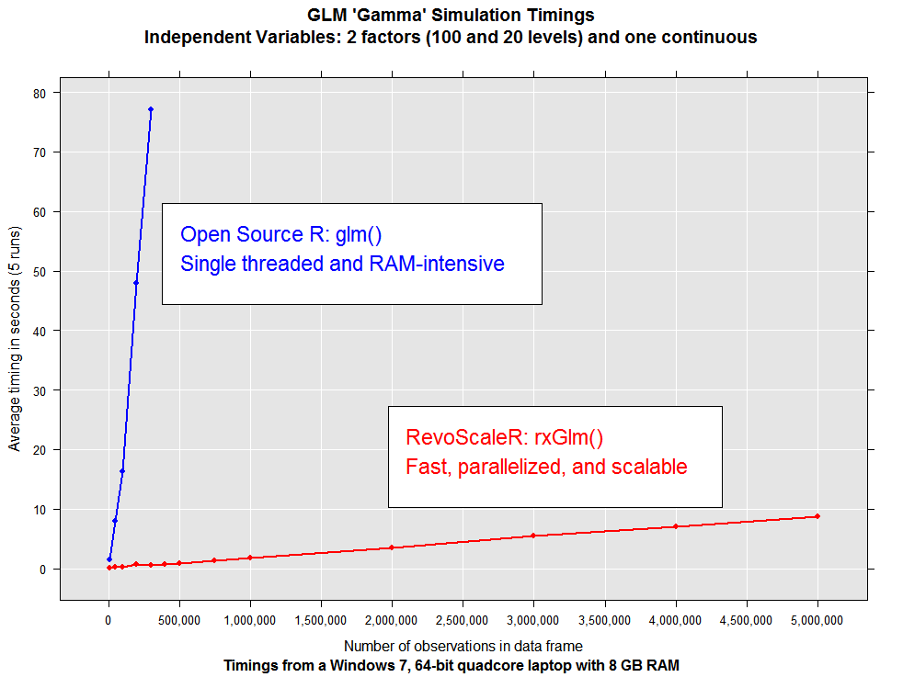
ScaleR: Dramatic Performance and Capacity

Slide 12
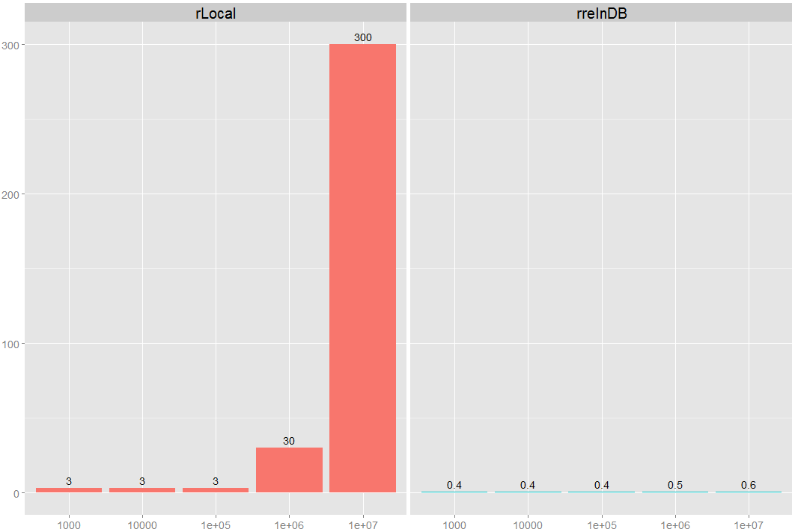
In-Database Acceleration
5+ hours to 40 seconds: Recommendation is that this now become the defacto productionalization process
R on a server pulling data via SQL
R on a server Invoking MRS ScaleR Inside the EDW
minutes
rows
Notes:
Work done in conjunction with major Teradata user and household name in silicon valley.
Chart shows results of moving R algorithm execution inside Teradata EDW – achieving combined benefits from scaling computation and slashing data movement.

Slide 13

MRS on Spark Compared to Open Source R
Preliminary measure
rxLogit in HDInsight
(Spark CC)
5 Spark Nodes is 122X Faster (~25x/node) than One CRAN R node running GLM
CRAN R glm
Configuration:
HDI cluster size: 5 nodes
Edge node:D14 V2 (16 cores, 112GB)
Worker Nodes: D12 (4 cores, 28GB)
Dataset: Airlines dataset (text format)
Number of columns: 44
Notes:
Slide Objective
Dig into a less than straightforward comparison of open source R (CRAN-R) to a configuration of R Server with Spark
Give you an opportunity to remind users that open source R can’t handle data larger than one machine.
Talking Points
We set forth to roughly compare CRAN-R to R Server with Hadoop and Spark
As you know, this comparison is naturally “apples to oranges” because:
CRAN-R isn’t designed to run on multiple CPUs and not generally larger than available memory.
Spark isn’t designed to run on one CPU. While it will run there, that is not what it is designed for.
So, we compared one node of R to 5 nodes of Spark.
Pitting open source CRAN GLM to rxGLM on spark (CRAN-R GLM to ScaleR GLM) results in an overall speed-up of 125x. At the cost of 5x the hardware.
On a per node basis, we arrive at roughly 25x speed-up at 1M rows with diverging (improving) relative speed for even larger files.
Note that at smaller file sizes, R Server Spark is still 3x faster per node (15x divided by 5 nodes) despite the “parallelization penalty” of starting tasks on multiple nodes.
As the file size grows, the performance advantage rapidly accelerates to 125x total or 25x per node at 1M rows.

Slide 14
MRS on Spark Compared to MRS on Hadoop
Spark
Preliminary measure
R Server on Spark generally 6x faster than MapReduce
MapReduce
Local
Configuration:
HDI cluster size: 5 nodes
Edge node:D14 V2 (16 cores, 112GB)
Worker Nodes: D12 (4 cores, 28GB)
Dataset: Airlines dataset
Number of columns: 44
… but local is the speed champion for smaller files
Notes:
Slide Objective
Present a comparison measure showing how much more efficient R Server is when using it with Spark vs. MapReduce.
Talking Points
This curve directly validates the speed-up of Spark. The green line shows how much faster Spark is than MapReduce for identical clusters. About 6x for the large file sizes.
As shown on the prior chart, the
One machine running locally beats 5 nodes of MapReduce up to 10M rows, and on per-node basis, is still faster at 1M rows. (the crossover is beyond 1m rows0. over MapReduce, despite running on a single node. MapReduce is only suitable for large file processing.
Node-for-Node, Spark accelerates beyond a local machine for data larger than 10M rows, (Look at the legend: 5 nodes of Spark is about 5 times faster than one node of R Server on a single server at about 10M rows)
Spark on the other hand, running on 5 nodes, vs 1 node of local compute,
Notes:
Study these charts and legends very carefully before trying to explain.
Compares one node R Server local to 5 nodes Mapreduce and 5 nodes Spark.
Do NOT dwell on MapReduce – it never really beats a single server on this chart on a node-for-node basis. Too much overhead. Focus instead on the Spark – MapReduce comparison resulting in 6x for “apples to apples” on the same cluster.

Slide 15
Scalability
Linear Scale out to 12B Rows
Preliminary measure
Configuration:
HDI cluster size: 100 nodes
Edge node:D14 V2 (16 cores, 112GB)
Worker Nodes: D12 (4 cores, 28GB)
Dataset: NY City taxi trip dataset
Number of columns: ??
Notes:
Slide Objective
Demonstrate that the performance is consistent and scalable once past the “zone of parallelization overhead”.
Talking Points
And how does it scale? Answer? Beautifully … As Expected …
Notice that once we get past the y axis intercept caused by parallelization effects and overheads, the curve “smooths out”.
We stopped measuring at 12M rows and saw no non-linearity

Slide 16
Today’s Focus
MRS With SQL Server R Services
Leverage the combined power of SQL and MRS
In database scaled analytics
MRS with HDInsight Spark
Leverage the combined power of MRS and Spark
In-memory distributed computing
Using Marketing Campaign Optimization Solution as an example
1-Click Deploy to DSVM with SQL Server: https://aka.ms/mrs-campaign
Code/Doc: https://github.com/Microsoft/r-server-campaign-optimization

Slide 17





Machine Learning Templates With SQL Server R Services
Marketing Campaign Optimization
Predictive maintenance
Retail customer churn
Online fraud detection
Retail forecasting
Energy forecasting
Repo:
https://github.com/Microsoft/SQL-Server-R-Services-Samples
Cortana Intelligence Gallery Link:
http://Aka.ms/SqlRtemplates

Slide 18
Introduction: Marketing Campaign Optimization Solution
Marketing Campaign
Predict customer response probability for a given campaign
Recommend campaign actions that optimizes response rate.
How to contact a customer (Call, Email, SMS)
When to contact a customer (Day of Week, Time of Day)

Slide 19

Steps 1-2: Data Processing and Feature Engineering
Importing the Input Datasets to SQL
Preprocessing & Feature Engineering
Campaign Detail
Product
Campaign Metadata
Product Metadata
Dataset for modeling
Pre-processing:
- Merging the 4 tables
- Missing Value Treatments
Feature Engineering:
Variable transformations
Demography
Market Touchdown
Demographic data of each lead
Historical Campaign Data

Slide 20



Step 3: Train and Evaluate Models (RF, GBT)
Splitting
Train & Test
Random Forest
Train & Test
Gradient Boosting
Random Forest is an ensemble model built by recursive partitioning to generate many decision trees
Gradient Boosting is an ensemble model built by combining the results of many under fitted models
Train Dataset
Train Dataset
rxDForest Function
Train Dataset
rxBTrees
Function
Analytical Dataset
70%
Random
Forest
Gradient
Boosting
Test Dataset
Test Dataset
Test Dataset
30%

Slide 21
Steps 4: Select the Champion Model and Provide Recommendations on Parameters
Evaluation & Champion Model Selection
Scoring for Recommendations
Random Forest
vs
Gradient Boosting
Lead ID | Channel | Day of week | Time of day | Predicted Conv. Rate
A | Email | Monday | Afternoon | 0.95
B | Cold Calling | Monday | Morning | 0.89
C | SMS | Tuesday | Evening | 0.82
D | Email | Friday | Afternoon | 0.81
Illustrative Output
Champion Model selection based on AUC
Performance metrics like AUC and Accuracy are used to compare the performance of the Model

Slide 22
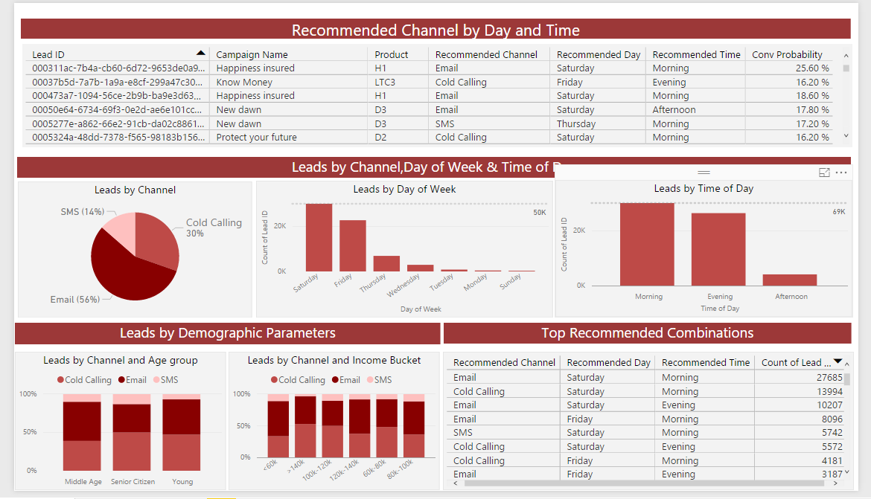
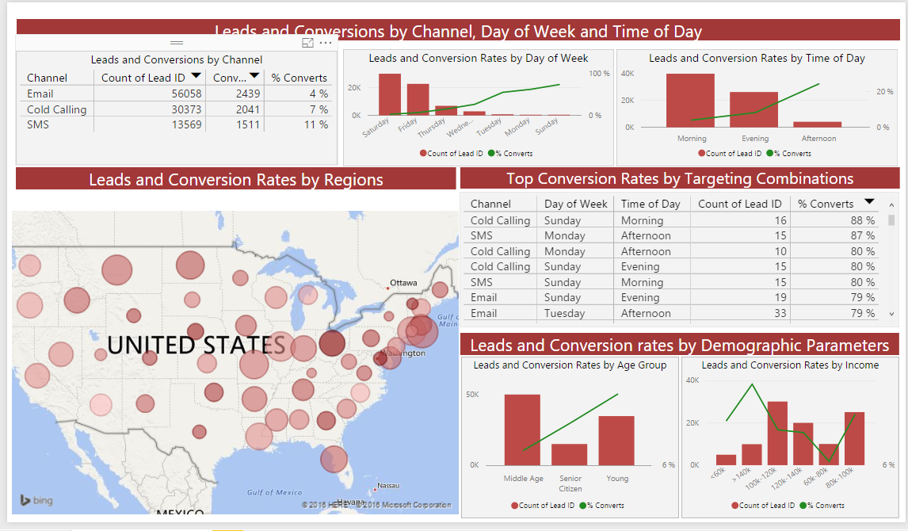
Finally, Visualize Results via Power BI Dashboard
Recommendations
Campaign Summary

Slide 23
MRS with SQL Server R Services

Slide 24
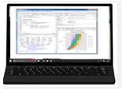

Model Development (R Users)
Working from R IDE on a local workstation, execute an R script that runs in-database on remote SQL server, and get the results back.
sqlCompute <- RxInSqlServer()
rxSetComputeContext(sqlCompute)
linModObj <- rxLinMod()
Data Scientist Workstation
2
Execution
SQL Server 2016
1
Script
R IDE
Advanced Analytics Extensions
3
Results
Microsoft R Open
Microsoft R Open
Microsoft R Server
Microsoft R Server

Slide 25
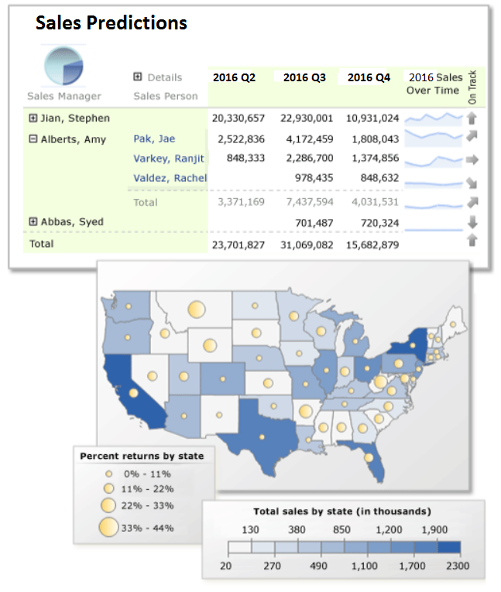
Model Operationalization with SQL R Services
R Code->T-SQL Stored Proc
Call a T-SQL System Stored Procedure to generate features and train (or retrain) the model
Call a T-SQL System Stored Procedure from my application and have it trigger R script execution in-database to predict on new dataset. Results are then returned to my application (predictions, plots).
1
Call System Stored Procedure
2
The stored procedure contains R code and
executes in-database
SQL Server 2016
Application
Results: scores, plots
3
Advanced Analytics Extensions
exec sp_execute_external_script
@language = ‘R’
, @script =
-- R code --
Microsoft R Open
Mcirosoft R Server

Slide 26
Solution Content
Sample datasets
Code for R IDE (Jupyter Notebook)
Code for SQL Stored Procedures
PowerShell script for end-to-end execution
PowerBI Dashboard
Documentation
1-Click Deployment (https://aka.ms/mrs-campaign)
Requires Azure Subscription

Slide 27
Develop with SQL Server 2016 R Services
Create SQL server data source: RxSqlServerData
Load/Save data into SQL table: rxDataStep
Create SQL compute context: RxInSqlServer
Feature engineering: rxDataStep(inData =…, outFile=…, transformFunc=…):
Train model: rxDForest
Score model: rxPredict

Slide 28
Step 1: Import data, Merge, and Clean
-> Code in R Notebook

Slide 29
Step 2: Feature Engineering
-> Code in R Notebook

Slide 30
Step 3: Splitting/Training/Testing
Code in SSMS

Slide 31
Step 4: Recommendations
Code in SSMS
Champion Model
Data
Full Table
Conversion Probabilities
Recommendations
For each Customer, create 63 duplicates with all combinations of Day, Time, Channel.
Score with Champion Model.
For each customer, select Day, Time and Channel with highest conversion prob.

Slide 32
Key Learnings (1/2)
1- rxExecuteSLDDL faster than rxDataStep for SQL query from R IDE.
2- No need to materialize the data sets for training, scoring or transformations with rxDataStep.
3- Privilege SQL queries against R code. Keep R for machine learning.
4- Use UPDATE STATISTICS on the populated tables after uploading data to SQL with PowerShell.
5- New environment or clear it from unnecessary objects before rxDataStep with user function.
6- rxDataStep modifies the variable types and lengths in SQL tables.
Use rxExecuteSQLDDL with “CREATE TABLE…” and specify data types. Then another rxExecuteSQLDDL with “INSERT INTO”.
7- Always specify factor levels for training and testing, using the same levels:
DATA_sql <- RxSqlServerData(table = “DATA", connectionString = connection_string, stringsAsFactors = T) # Point to the full table converting strings to factors.
column_info <- rxCreateColInfo(DATA_sql) # Get the types and levels for factors.
DATA_Train_sql <- RxSqlServerData( table = “DATA_Train”, connectionString = connection_string, colInfo = column_info) # Point to training set with colInfo.

Slide 33
Key Learnings (2/2)
8- Data Types: characters faster than factors. Convert to factors only before training/testing.
9- Known issue of slowness with Azure VM for some algorithms because of slow disk I/O.
10- rxDataStep:
cannot write into a table when 2 columns have the same name (possible in SQL).
cannot do transformations in-place (inData and outFile should be different).
varsToKeep and varsToDrop not supported (use SQL queries instead or transforms = list (Variable = NULL)).
new variable creation: use .rxNumRows instead of numrows(data) (transformations done by chunk).
rowSelection for rows subset: might not work if using existing variable. Set directly rowSelection = logical expression.

Slide 34
Learnings about Normalization in SQL
Scoring with character factor levels can lead to speed issues.
Method 1: store the factor levels as integers and then specify their type as factorIndex when training or testing models. BUT implementation issues.
Method 2: store the factor levels as “stringed integers”.
E.g: Age: “Young”, “Middle Age”, and “Senior Citizen” converted to “1”, “2”, “3”.
=> Method 2 increased scoring speed by more than 10%, mainly because writing/ reading shorter strings in the tables.

Slide 35
Learnings about Compute Contexts (1/2)
For SQL CC, we can use the argument numTasks.
= number of processes to run in parallel, making use of the multiple cores.
BUT depending on the algorithm, the machine, the data set and numTasks:
numTasks = 1 (default) can be faster.
Local CC can be faster.
In this solution:
- numTasks >1 was not implemented for memory limitations.
- When Local CC was faster than SQL CC with numTasks = 1, Local CC was used.

Slide 36
Learnings about Compute Contexts (2/2)
1- rxExecuteSQLDDL independent of the CC.
2- rxDataStep for SQL queries: speed ↑ if numTasks ↑ and SQL CC becomes faster than Local CC.
3- rxCreateColInfo is fastest in Local CC or SQL CC with numTasks = 1.
4- Training is very slow in Local CC.
- If training set not materialized: fastest with SQL CC and numTasks = 1.
- If training set materialized: fastest with SQL CC and any numTasks.
5- Scoring: speed ↑ when numTasks ↑ and SQL CC becomes faster than Local CC.
General advice: speed, CC and numTasks are machine, algorithm, and data set dependent.
=> Try the different CC and numTasks to make sure you are using the fastest.

Slide 37
MRS with Apache Spark

Slide 38
Outlines
Introduction
Sample code
Performance comparison with benchmarks
Learnings
Summary

Slide 39
Introduction: Spark and MRS
Apache Spark
Open source cluster computing framework
An implementation of MapReduce for distributed computation
In-memory computing and efficient parallelization
MRS on HDInsight with Apache Spark
Azure blob storage serves as HDFS
Provides latest capabilities for R-based analytics on large datasets
Edge node provides a convenient place to connect to the cluster and run your R scripts

Slide 40
Introduction: Spark Cluster Set up
Create HDInsight Cluster with R server from Azure portal: https://docs.microsoft.com/en-us/azure/hdinsight/hdinsight-hadoop-r-server-get-started
Install Rstudio with R Server on HDInsight: https://docs.microsoft.com/en-us/azure/hdinsight/hdinsight-hadoop-r-server-install-r-studio

Slide 41
Introduction: Configurations
Spark Cluster:
1 Edge node with 8 cores
2 head nodes with 8 cores in total
4 worker nodes with 32 cores in total
3 zookeeper nodes with 6 cores in total
Local Desktop
Processor: Intel(R) Xeon(R) CPU E5-1620 v3 @ 3.50GHz, with 4 cores and 8 threads
32 GB RAM

Slide 42
Sample Code: Step1, Data Processing
Load data as DataFrame in SparkR
Register DataFrame as temporary table
Apply SQL command to merging temporary tables
Clean missing values for the final merged table

Slide 43
Sample Code: Step2, Feature Engineering
Create features counting how many times each Lead ID is contacted by different channels
Create lag variables for channel for each Lead ID
Keep the latest record for each Lead ID

Slide 44
Sample Code: Step3, Training and Evaluation
Change string columns to factors
Split data into training and testing
Train RF and GBT models
Evaluate the performance and select the best model

Slide 45
Sample Code: Step4, Recommendations
Create table with all unique combinations of Day_of_week, channel and time_of_day.
Join the new created table with original data, so that every record in original data is expanded to all unique combinations of Day_of_week, channel and time_of_day.
Score the joined table.
Select the rows with highest scores for each Lead ID as recommendations.

Slide 46
Performance Comparison
MRS with Spark CC VS. CRAN-R
RF Model (40 trees) | 700K training | 10M training | 100M training
CRAN-R | 4.1 mins | crushed | crushed
MRS (Spark CC) | 2.3 mins | 20.9 mins | 2.6 hours
GBT Model (40 trees) | 700K training | 10M training | 100M training
CRAN-R | gbm package not work properly | crushed | N/A
MRS (Spark CC) | 8 mins | 1+ hour | N/A

Slide 47
Performance Comparison
MRS VS. SparkR
Logistic | 700k training | 10M training
SparkR GLM | 4.9 mins | 21 mins
MRS with Spark CC | 1.8 mins | 2.5 mins

Slide 48
Learnings: Data Source
Xdf format is the most efficient data source. It is required to specify “filesystem” as spark when creating Xdf file on HDFS using RxXdfData function.
The Xdf file on spark cluster is a directory, while on local edge node is a .xdf file.
RxXdfData function doesn’t take column information as input.
Use rxFactors to change string to factor
Apply rxFactors to the whole data set before splitting into training and testing

Slide 49
Learnings: Functions
rxMerge/rxSort functions are not supported for spark compute context. Solutions:
Use rxHadoopCopyToLocal to move data from HDFS to local edge node. Apply rxMerge/rxSort with local CC.
Use SQL command in SparkR package
Be extremely careful when wrapping customized function into rxDataStep function. Examples:
Replace NA values by global mode
Calculate rolling means

Slide 50
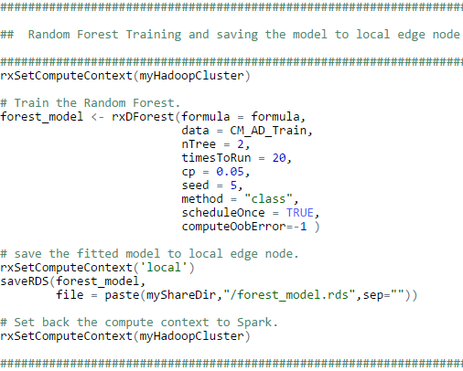
Learnings: RF Model Optimization
Train RF model using rxDForest function:
scheduleOnce = TRUE when data size is small to moderate (less than 10M records)
Use ntree and timesToRun to control total number of trees (if scheduleOnce = FALSE, timesToRun is an unused argument)
comupteOobError = -1 to avoid calculating OOB errors
xVal = 0 to avoid cross validation

Slide 51
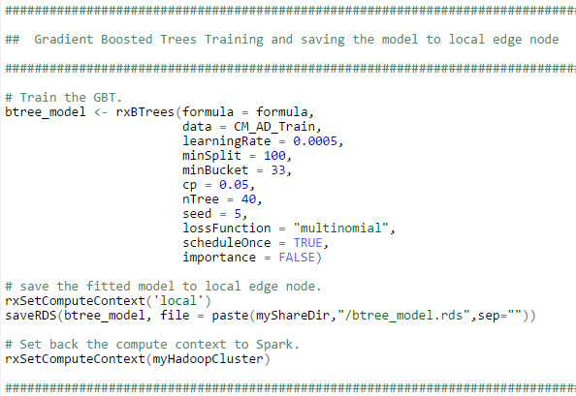
Learnings: GBT Model Optimization
Train GBT model using rxBTrees function
“timesToRun” argument not working for rxBTrees
Loss function set to “Bernoulli” which is faster than “Multinomial”

Slide 52
Learnings: SparkR package
SparkR works with DataFrame which is RDD
Use sparkR.stop() to stop sparkR session when finish
Function name conflicts. Solutions:
Add package name before the function
DO NOT detach SparkR package
When use “write.df” function to export DataFrame to .csv file on HDFS, specify the file as a directory instead of a .csv file

Slide 53
Summary
Pros:
MRS is powerful and scalable to big data analysis by leveraging the diversity of open source R packages, routines in ScaleR and spark.
Azure blob storage provides the convenience to manage data on HDFS from your local machine
Cons:
Some “rx” functions are not supported under spark compute context
Can’t work properly along with SparkR package
rxDataStep function is tricky to use

Slide 54
Appendix

Slide 55
Hands-on Session

Slide 56
Instructions for SQL/MRS Hands-On
4 DSVMs were deployed and set up.
Users should be divided into 4 groups. In your web browser:
- DSVM 1: https://104.42.126.48:9999
- DSVM 2: https://40.83.180.132:9999
- DSVM 3: https://137.117.9.5:9999
- DSVM 4: https://23.99.11.130:9999
Password is: D@tascience2016
Run"Create User Directory.ipynb" in notebooks/MLADS_Tutorial_SQLR
Navigate to the folder with your alias name and run SQL or R notebook.

Slide 57
Contact Us xixue@Microsoft.com casarouf@microsoft.com yuso@Microsoft.com Jaren@Microsoft.ocm

